Slide 1
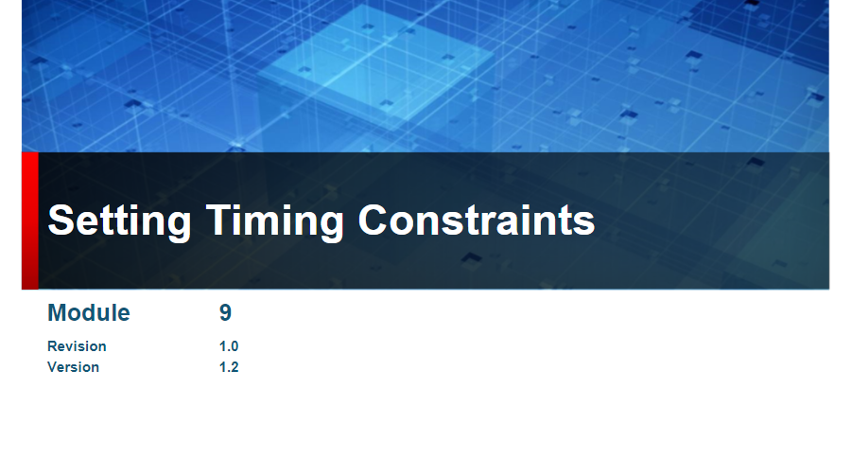

Slide 2
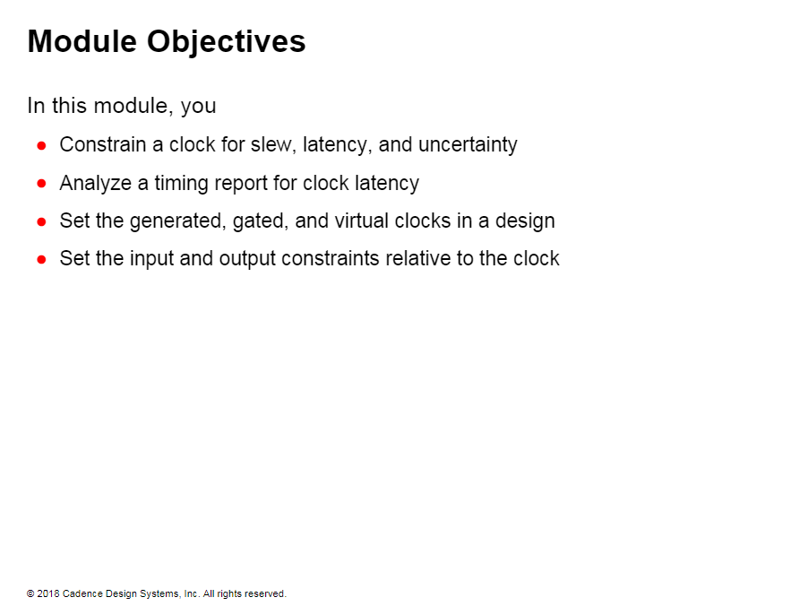

Slide 3
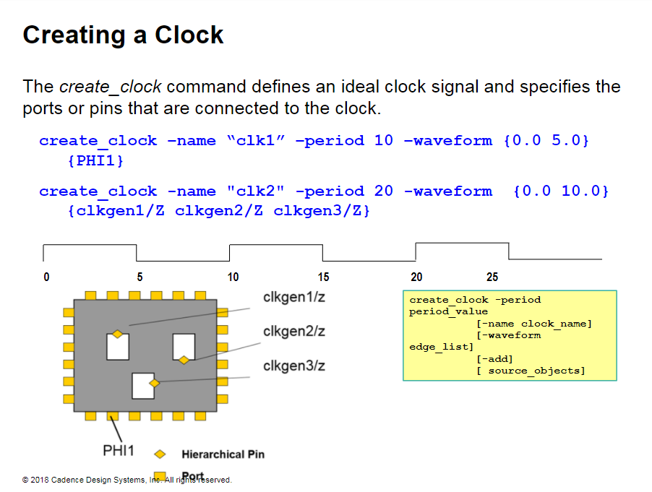
Notes:
Creating a Clock
The create_clock command creates a clock object with an ideal signal and specifies the ports or pins connected to the clock source. The ideal signal has a period and waveform. The duty cycle is derived from the period and the waveform.
The first example command above defines an ideal clock that is connected to the PHI1 port. The ideal clock is named clk1 and has a period of 10ns, a leading-edge at 0. a trailing edge at 5ns, and a duty cycle of 50%.
In the second example above. the command sets an ideal clock named clk2 on three clock pins. clkgen1/Z. clkgen2/Z. and clkgen3/Z. This clock has a period of 20ns and a duty cycle of 50%.
You can now use the clk2 object to modify the clock signal on all three pins. clkgen1/Z. clkgen2/Z. and clkgen3/Z.

Slide 4
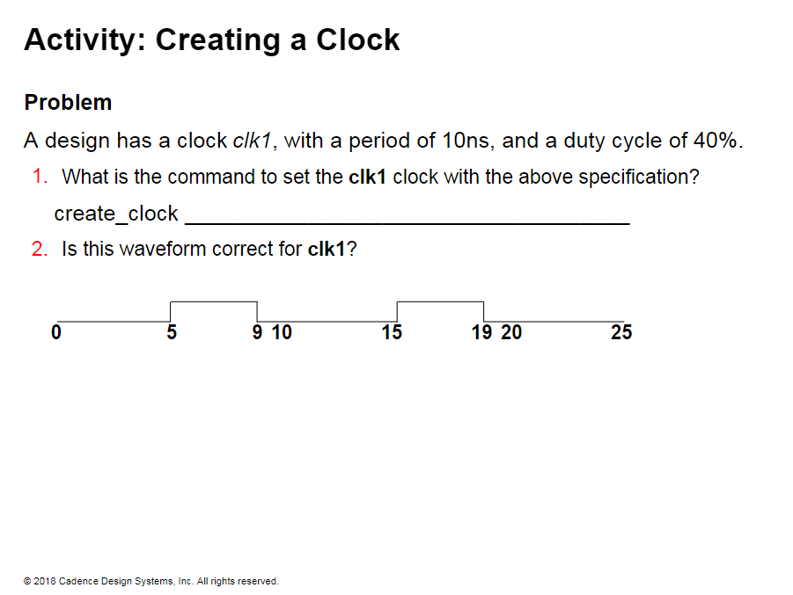

Slide 5
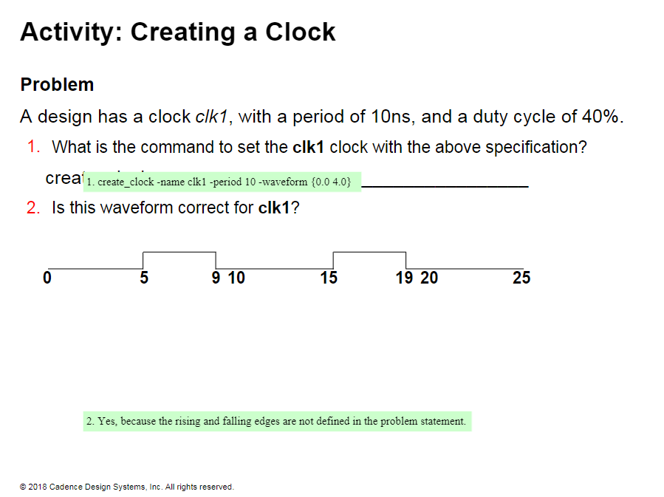

Slide 6
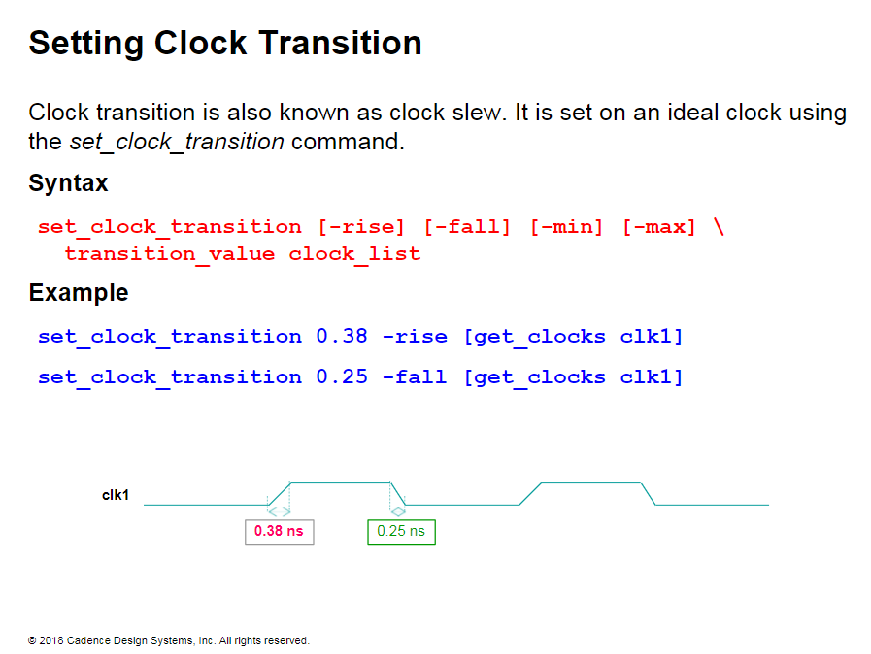
Notes:
Setting Clock Transition
Just like all other signals, clocks have rise and fall times.
The fanout of the clock is much greater than that of most other signals. Thus, the output slew degrades as the clock signal propagates through the cells.
STA tools keep track of the maximum transition time on all the signals including the clock.
After creating the ideal clock you need to refine it with specifics.
To model the real nature of a clock. you add transition time. uncertainty. and latency to the ideal clock.
The above example specifies a slew of 0.38ns on the rising edge of the ideal clock, CLK1. and a slew of 0.25ns on the falling edge.
Notice that the get_c/ocks command specifies the clock object to pipe the actual clock signal and the related ports to the set_clock_transition command.

Slide 7
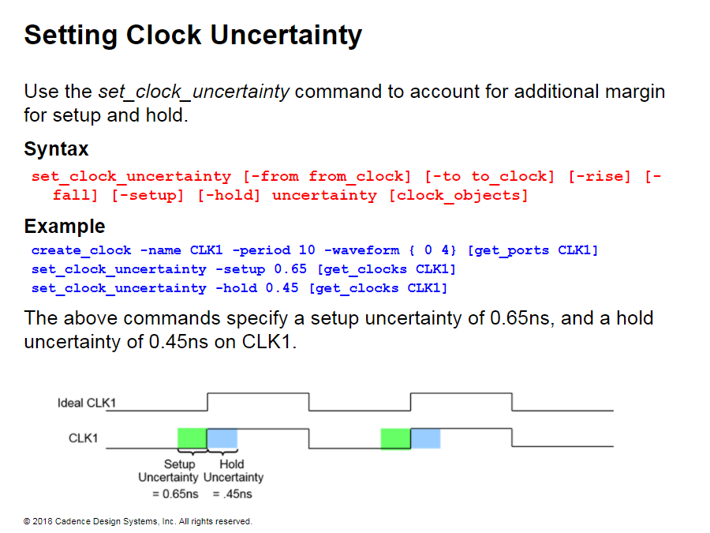
Notes:
Setting Clock Uncertainty
Use this command to specify uncertainty (skew + jitter) of clock networks.
Simple uncertainty specifies setup and hold uncertainties for all paths to the endpoint.
Interlock uncertainty specifies skew between clock domains.
In ideal mode, set the uncertainty value to the worst skew expected at the end point or between the clock domains plus any additional jitter.
In propagated mode, set the uncertainty to include only jitter. because the STA tool calculates skew from the clock tree.

Slide 8
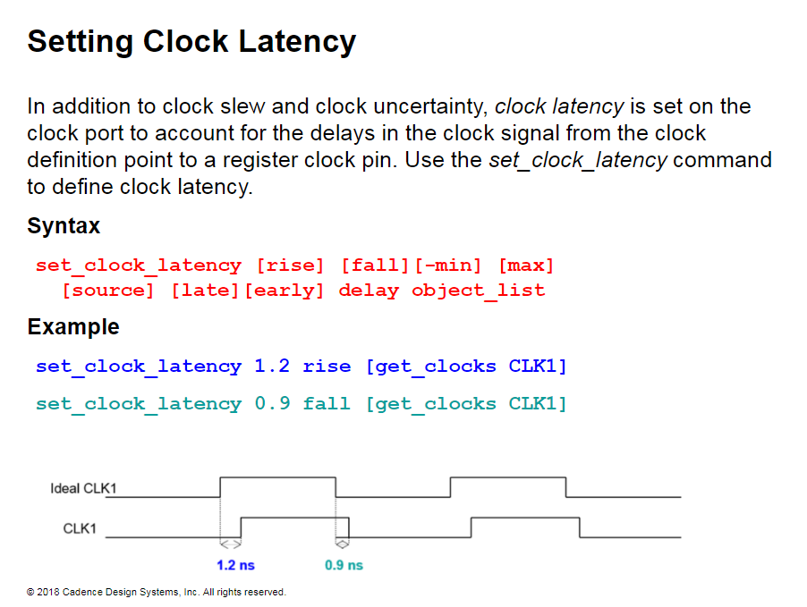
Notes:
Setting Clock Latency
For generated clocks, you can use the set_clock_latency command to model the delay from the master clock to a generated clock definition point.
Use rise and fall clock latency settings to determine the appropriate transition (slew) times of the clock signal from the library.

Slide 9
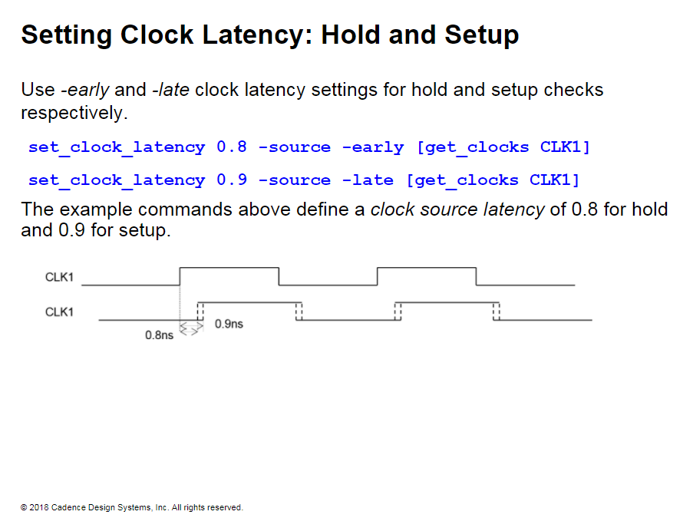
Notes:
Setting Clock Latency: Hold and Setup
The following commands describe an ideal clock with a period of 10ns, a waveform of {0 5}. arise and fall clock latency of 0.8ns. a hold uncertainty of 0.3ns. and a setup uncertainty of 0.2ns.
create_clock -name "CLK" -period 10 -waveform {0.0 5.0}
set_clock_latency 0.8 -rise [get_clocks CLK]
set_clock_latency 0.8 -fall [get_clocks CLK]
set_clock_uncertainty -setup 0.2 [get_clocks CLK]
set_clock_uncertai nty -hold 0.3 [get_clocks CLK]

Slide 10
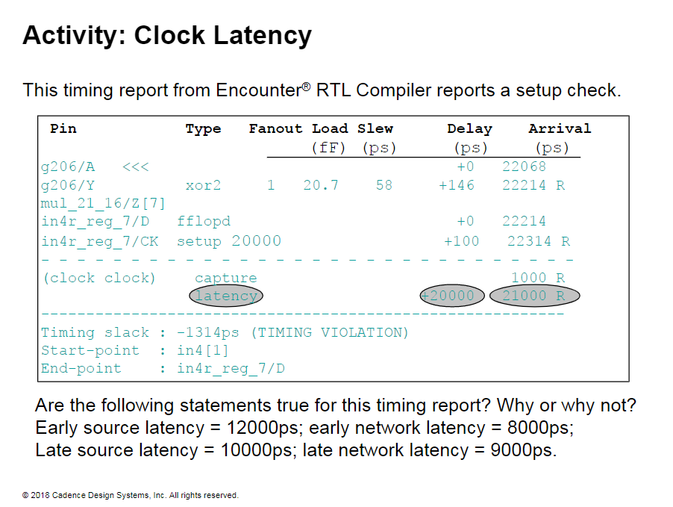

Slide 11
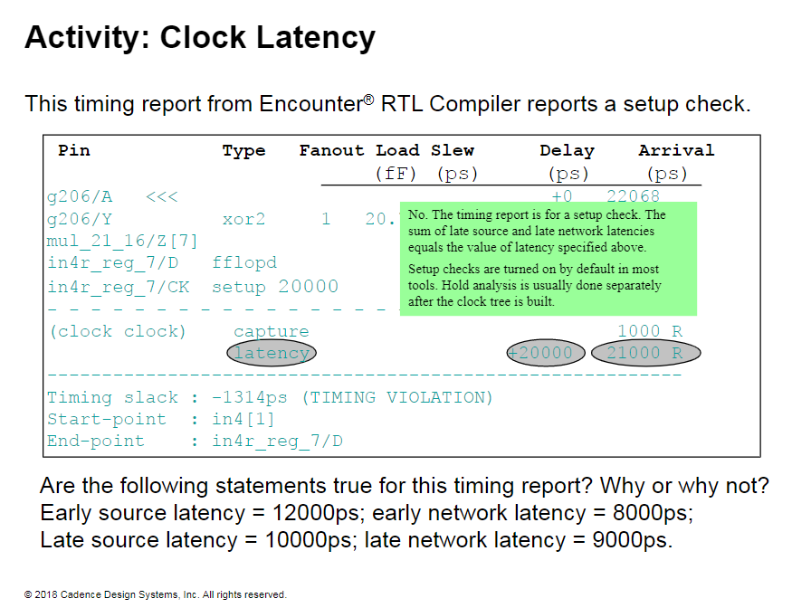

Slide 12
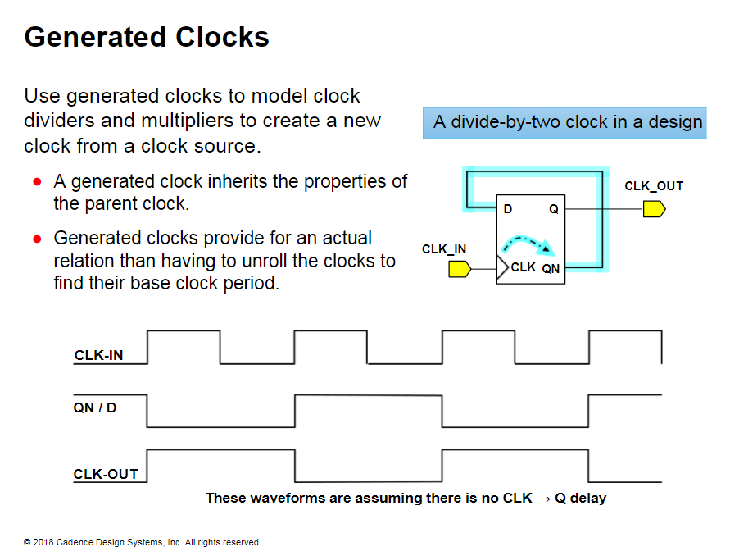

Slide 13
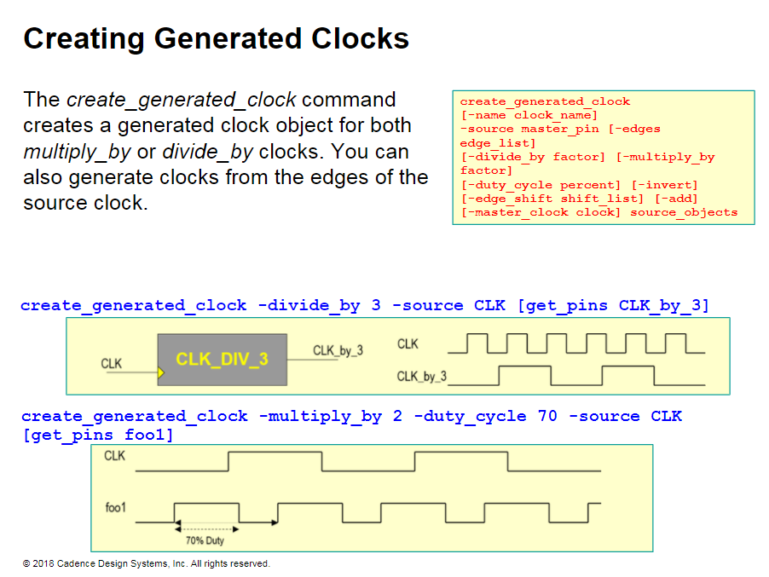
Notes:
Creating Generated Clocks
A generated clock is a fraction of or a multiple of the source clock. The purpose of creating a generated clock is to inherit the properties of that source clock.
The create_generated_clock command models the output of clock multipliers and clock dividers.
The create_generated_clock command also defines a relationship between the clocks, instead of having to unroll the clocks to find their base clock period.
In the first command, the generated clock period is one third of the source clock period, and this relationship is used to calculate the phase shift and to verify data transfer.

Slide 14
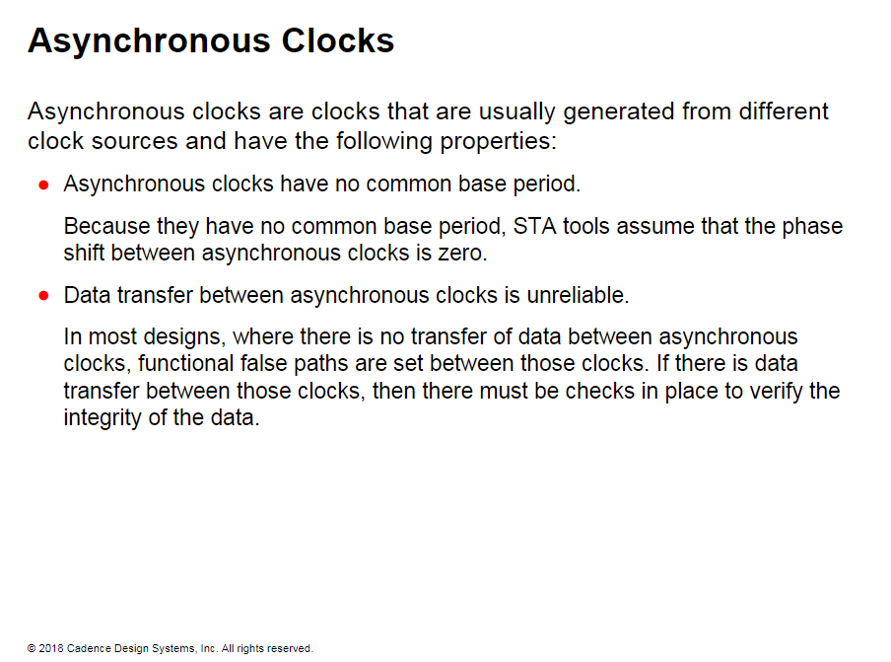
Notes:
Asynchronous Clocks
Asynchronous clocks are clocks that are generated outside the chip from different clock sources.
Because the clocks are asynchronous. the data transfer between them is unreliable.
You must tell the STA tool that the paths between these clocks do not exist so that the STA tool will not time these paths.

Slide 15
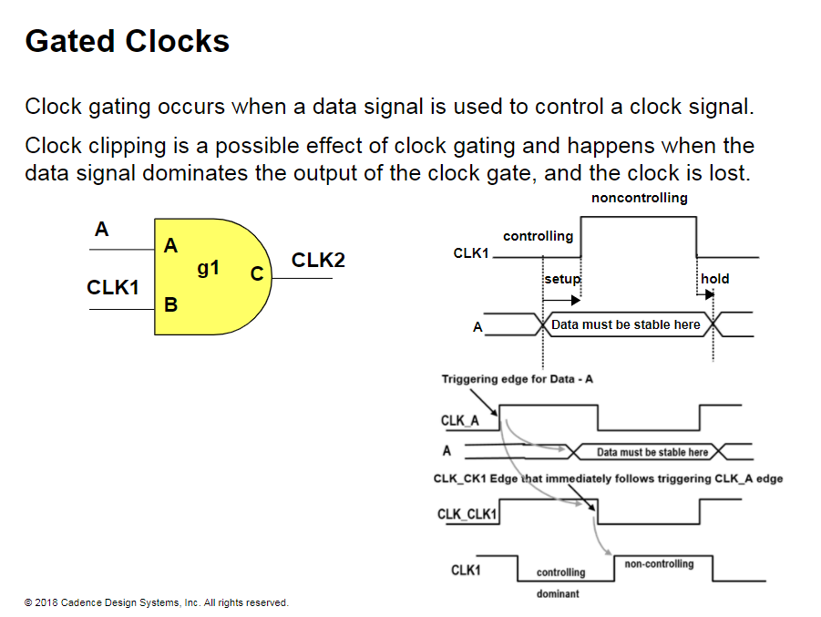
Notes:
Gated Clocks
In this illustration, when input A is at logic 1, the CLK1 input propagates to the output CLK2 as is.
When A is 0. the output also becomes logic 0.
Therefore. CLK2 is a gated clock signal controlled by the A input.
The setup and hold checks make sure that data is stable when a clock is making a transition.
A violation of either check implies that clock input is not properly propagated to the output.
In addition to the setup and hold checks, another check to ensure that the clock output is not distorted is the clock clipping check. The clock clipping check ensures that the data input is stable when the clock is not dominant. The dominant logic value for clock input is 0 for AND and NAND gates, while it is 1 for OR and NOR gates.
For example. if CLK_CLK1 is the clock root for CLK1, and CLK_A is the clock root for data signal A. then verify whether the clock will be clipped or not.
You can check the relationship between the periods of the two clocks.
using these equations:
CLK_CLK1=CLK_A
or
CLK_A = <integer> * CLK_CLK1
If both the above conditions are not satisfied. then the clock is clipped.

Slide 16
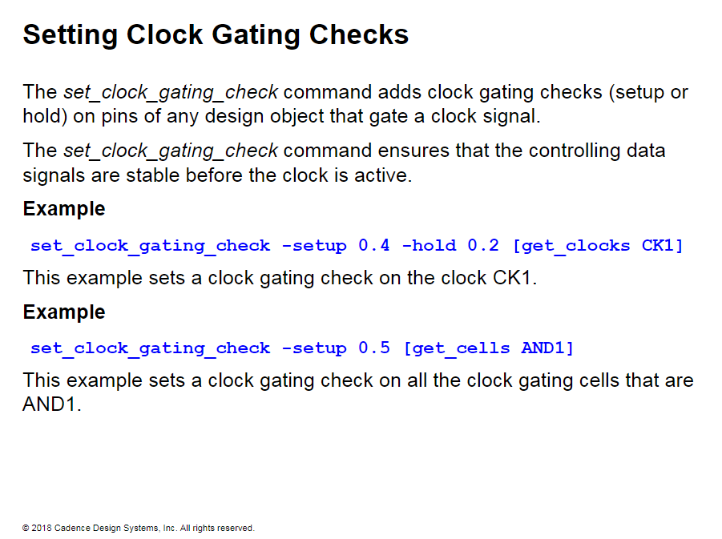

Slide 17
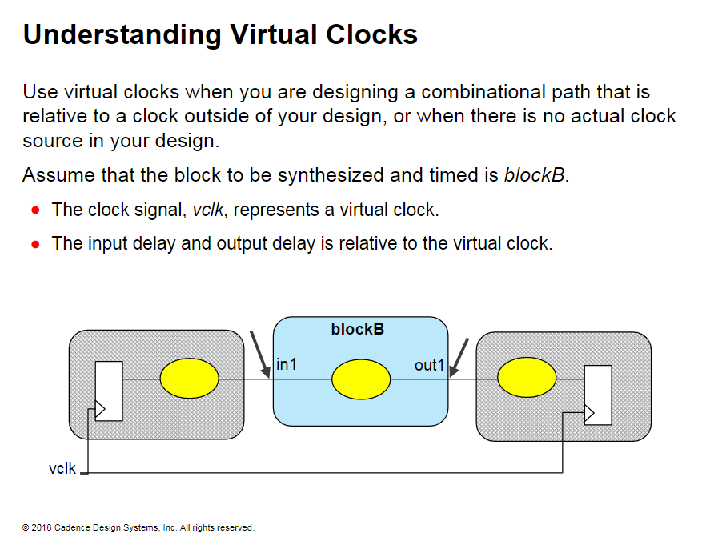
Notes:
Understanding Virtual Clocks
Virtual clocks are used during optimization. They do not really exist in the circuit.
You can define a virtual clock with the create_clock command, but you do not bind it to a port.

Slide 18
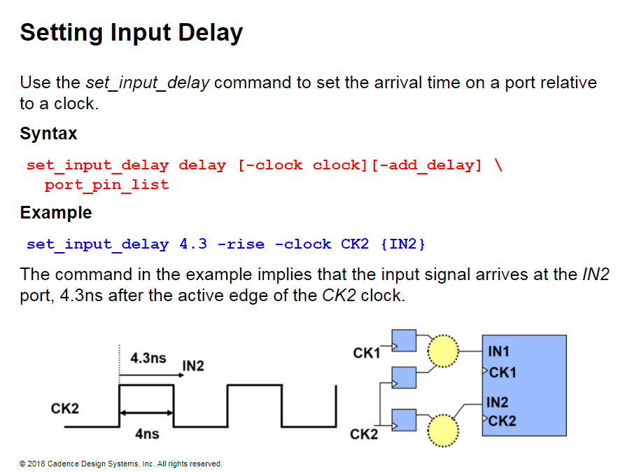
Notes:
Setting Input Delay
The timing of the surrounding modules (blocks or other chips) is an important factor in properly constraining synthesis.
For bidirectional ports, you can specify the path delays for both input and output modes.

Slide 19
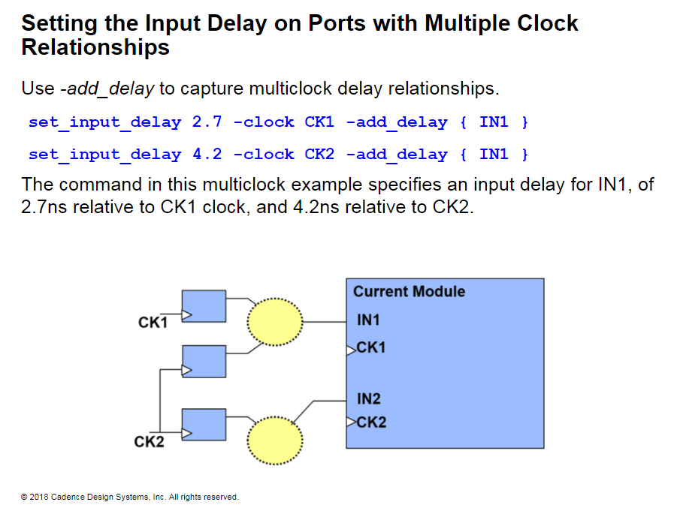

Slide 20
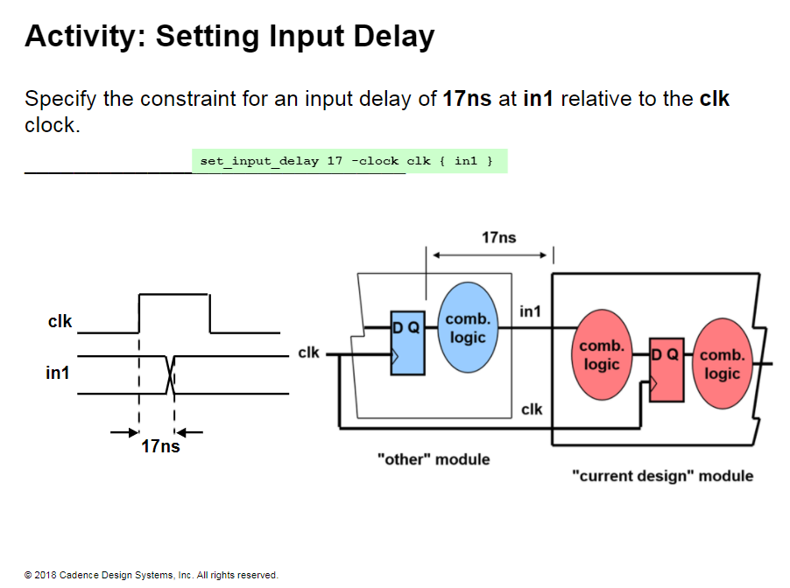

Slide 21
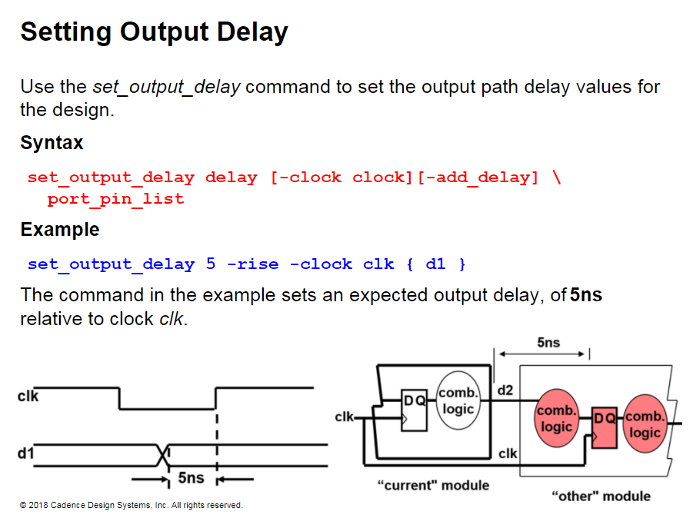
Notes:
Setting Output Delay
The timing of the surrounding modules (blocks or other chips) is an important factor in properly constraining synthesis.

Slide 22
